Slide 1

Consumer goods Ad-hoc Insight

Slide 2
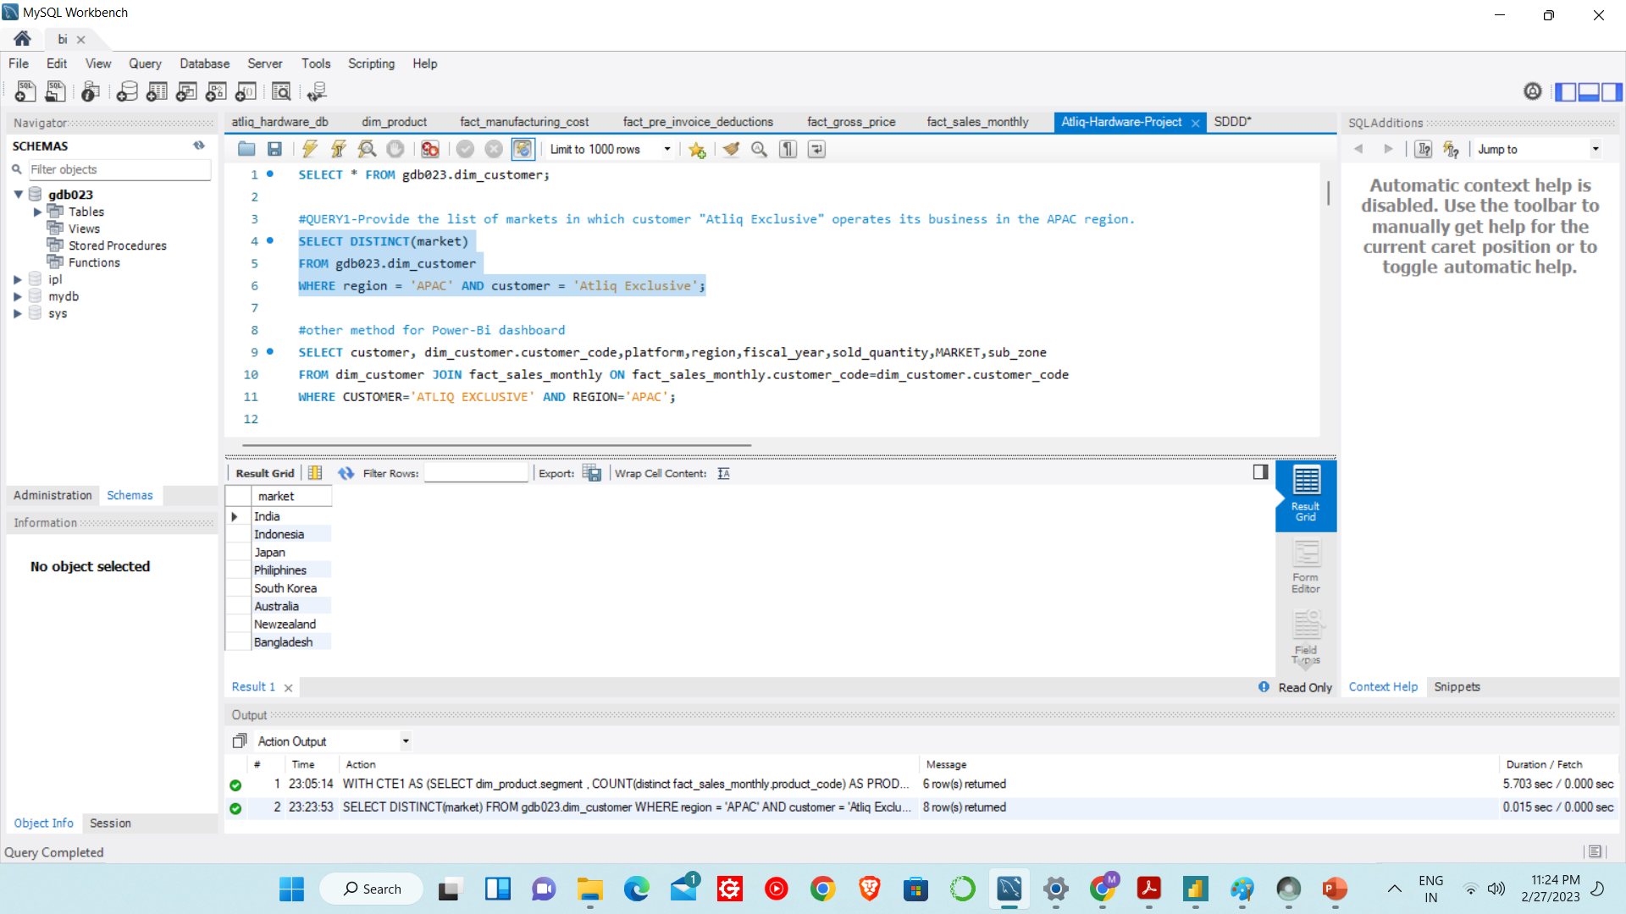
Yearly report
Question-1:-
Provide the list of markets in which customer "Atliq Exclusive" operates its business in the APAC region.
Output:-

Slide 3
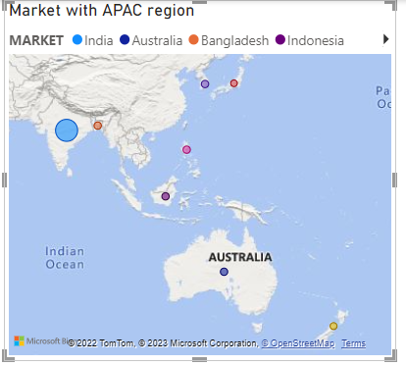
Insights
INDIA with 224 numbers is Top most market in which customer "Atliq Exclusive" operates its business in the APAC region
In JAPAN(107) customer “Atliq Hardware” has less numbers.

Slide 4
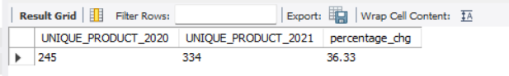
Question-2:-
What is the percentage of unique product increase in 2021 vs. 2020? The final output contains these fields,
unique_products_2020
unique_products_2021
percentage_chg
Output:-

Slide 5
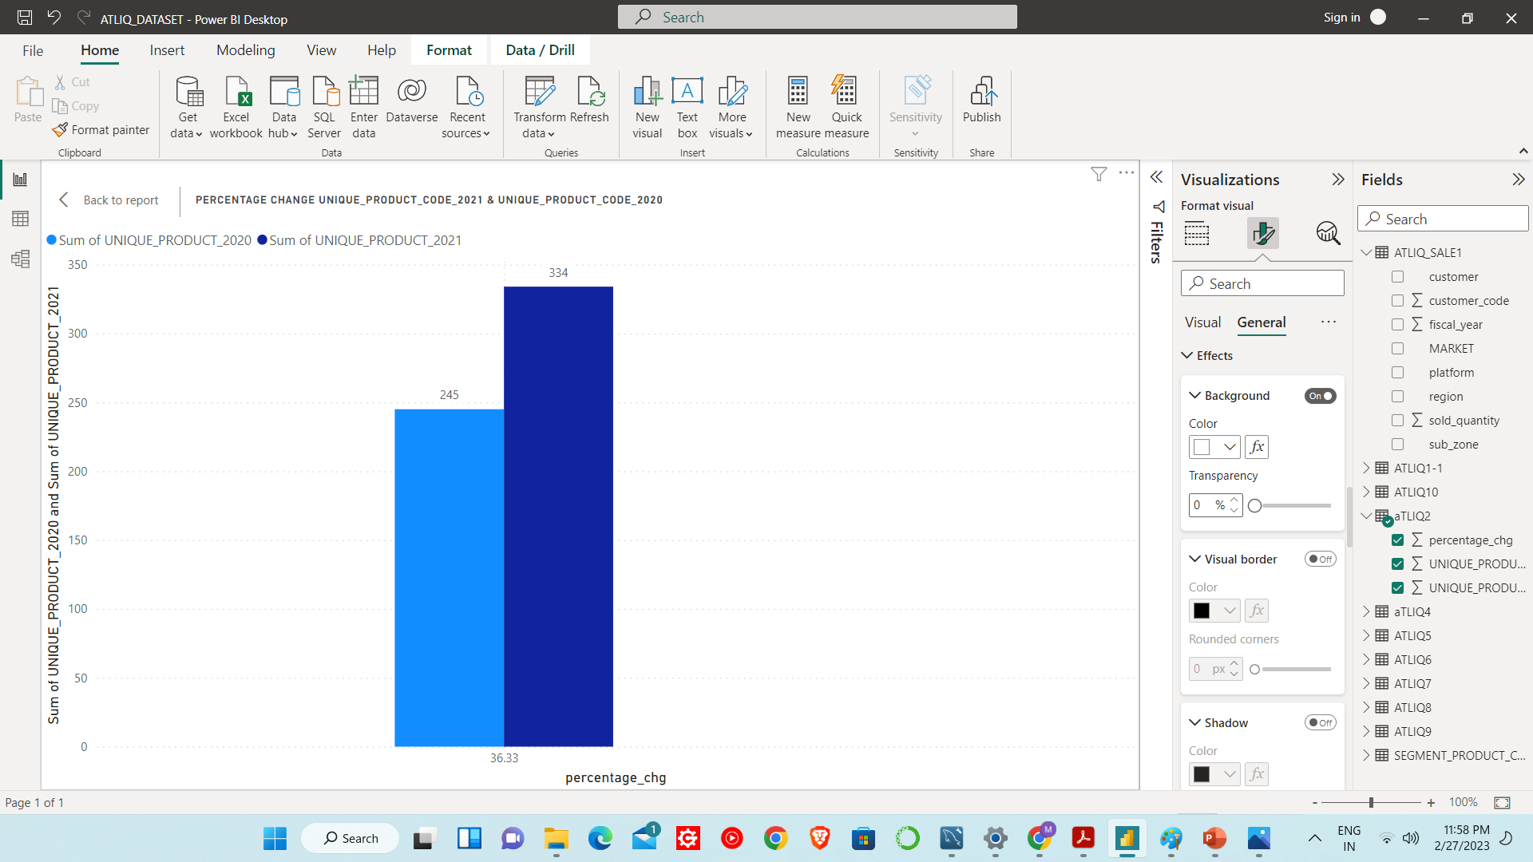
The sales of Unique products from fiscal year 2020 to fiscal year 2021 has been increased by 36.33%

Slide 6
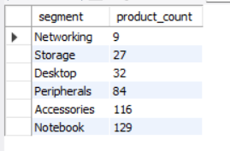
Question-3:-
Provide a report with all the unique product counts for each segment and sort them in
descending order of product counts. The final output contains 2 fields,
segment
product_count
Output:-

Slide 7
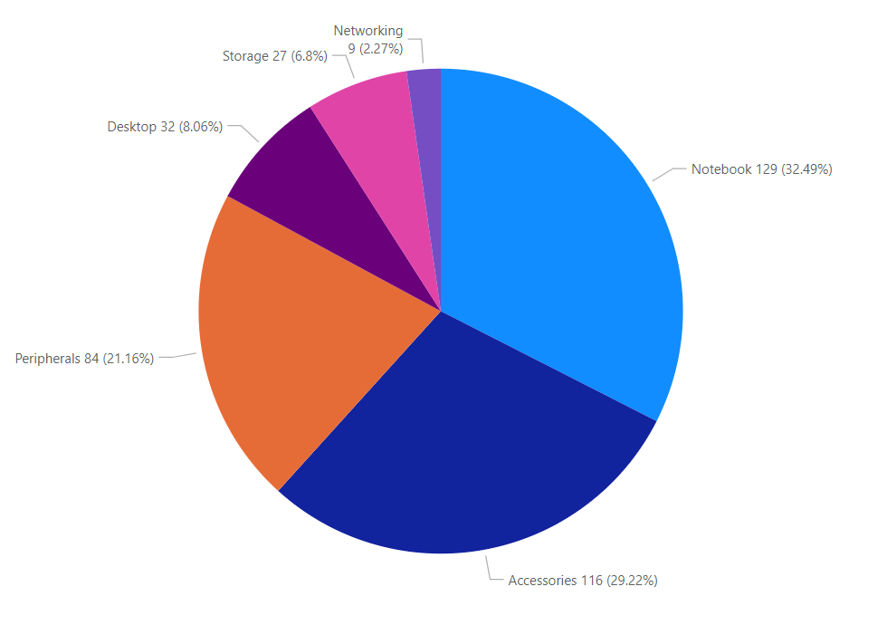
Networking Segment has lowest counts of Unique products
Notebook has highest number of counts of unique products

Slide 8
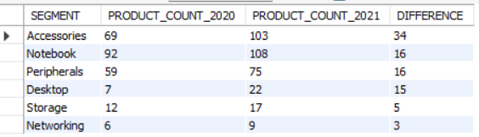
Question-4:-
Which segment had the most increase in unique products in 2021 vs 2020?
The final output contains these fields,
segment
product_count_2020
product_count_2021
difference
Output:-

Slide 9
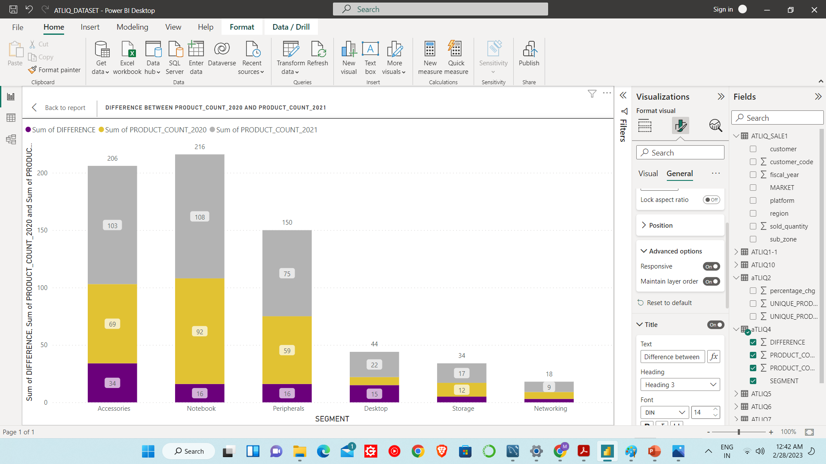
Accessories segment had increase the unique product counts on YoY basis

Slide 10
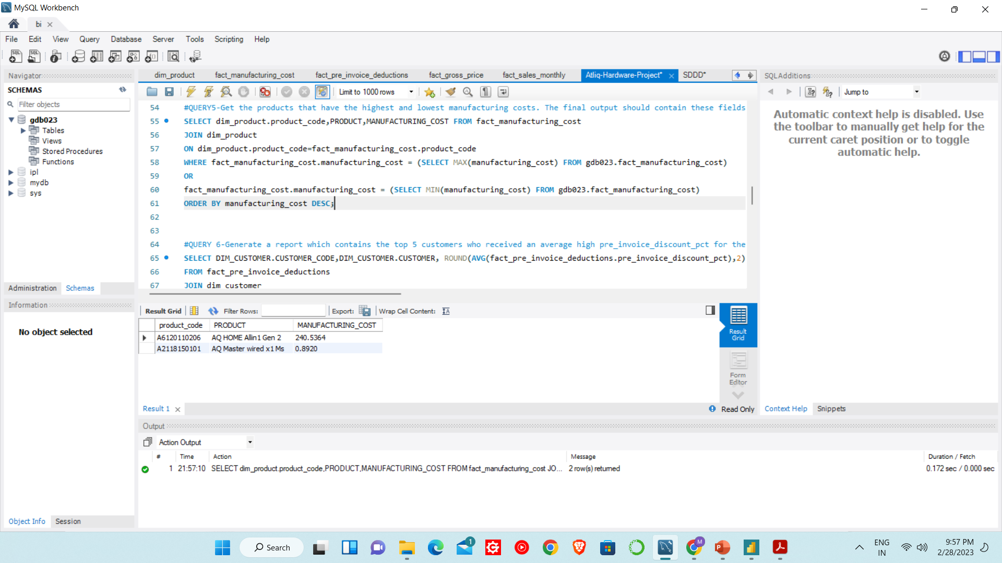
Question5:-
Get the products that have the highest and lowest manufacturing costs.
The final output should contain these fields,
product_code
product
manufacturing_cost
Output:-
As we can see “AQ HOME Allin1 Gen 2” has highest manufacturing cost & “AQ Master wired x1 Ms” has lowest manufacturing cost.

Slide 11
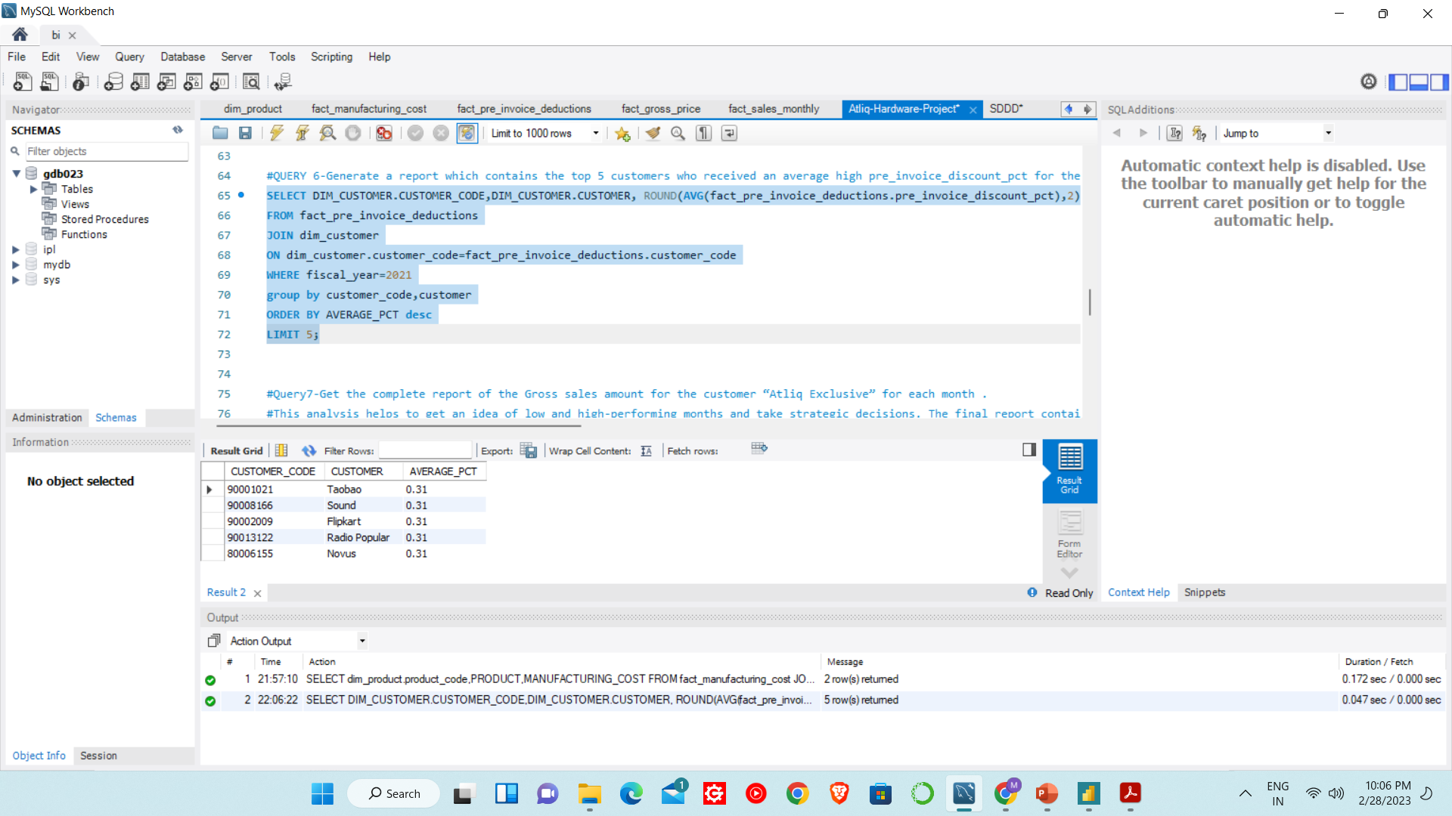
Question-6:-
Generate a report which contains the top 5 customers who received an average high
pre_invoice_discount_pct for the fiscal year 2021 and in the Indian market. The final output contains these fields,
customer_code
customer
average_discount_percentage
Output:-

Slide 12
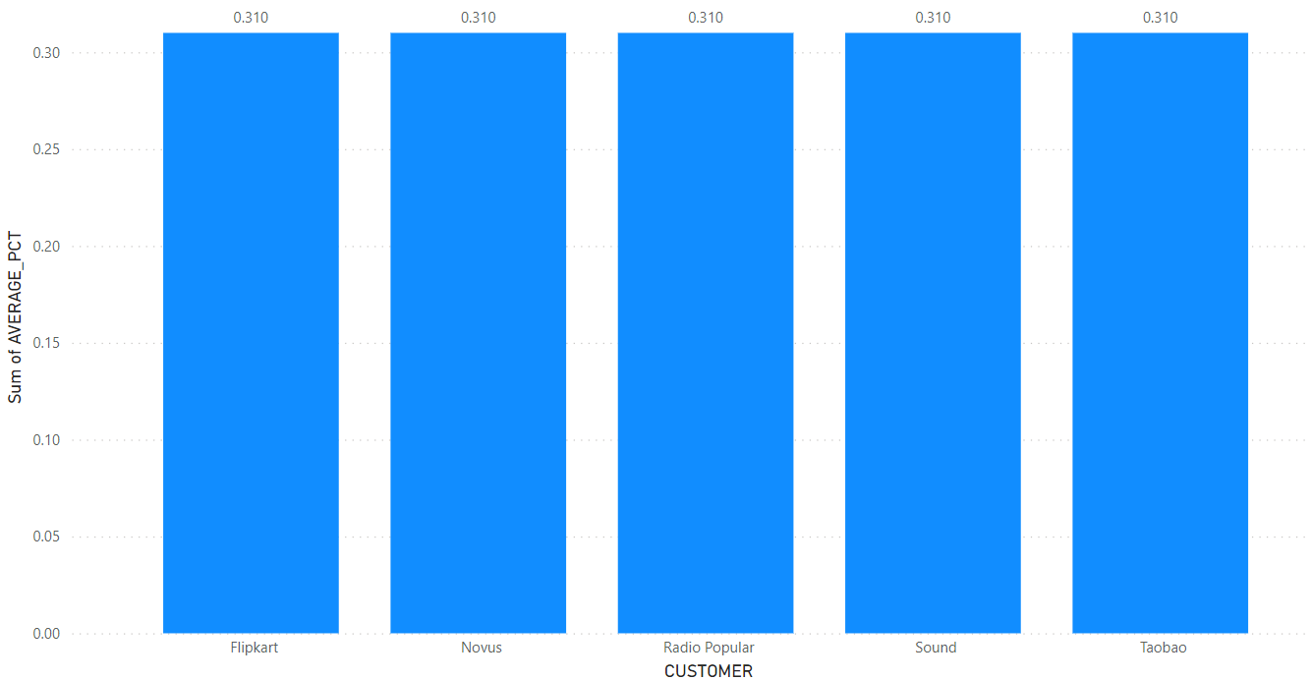
As we can see all top 5 have average discount percentage of 0.31

Slide 13
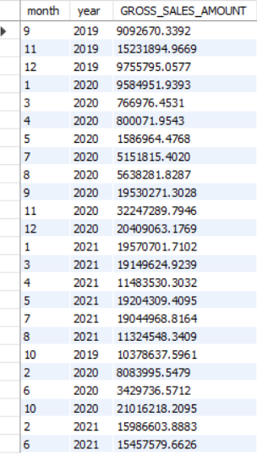
Question-7:-
Get the complete report of the Gross sales amount for the customer “Atliq Exclusive” for each month . This analysis helps to get an idea of low and high-performing months and take strategic decisions. The final report contains these columns:
Month
Year
Gross sales Amount
Output:-

Slide 14
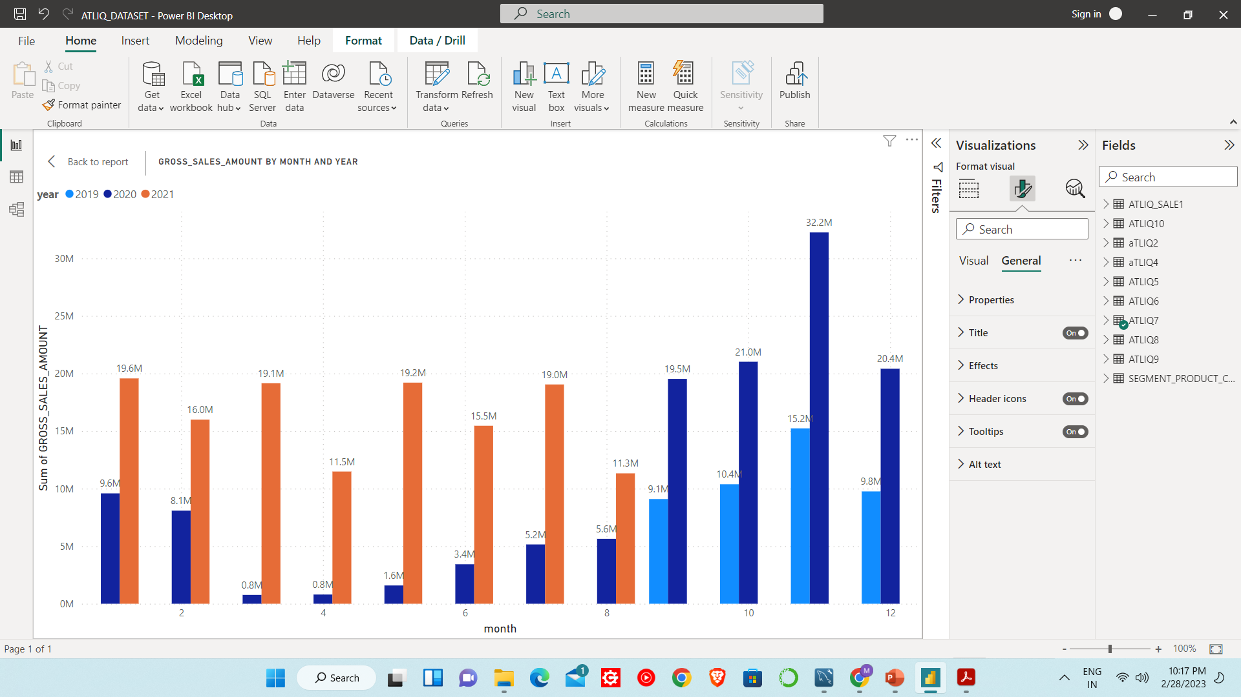
Highest sale of amount 32.2M In Nov. 2020
Lowest sale of amount 0.8M in March & April 2020

Slide 15
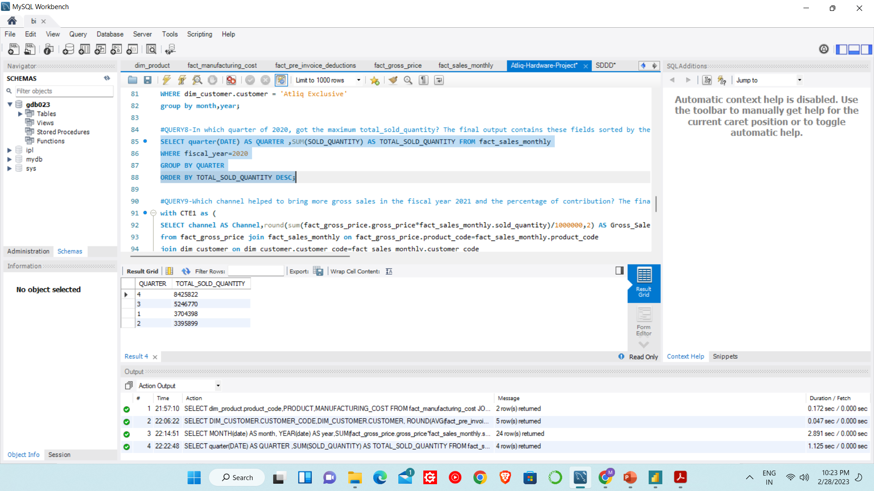
Question-8:-
In which quarter of 2020, got the maximum total_sold_quantity? The final output contains these fields sorted by the total_sold_quantity,
Quarter
total_sold_quantity
Output:-

Slide 16
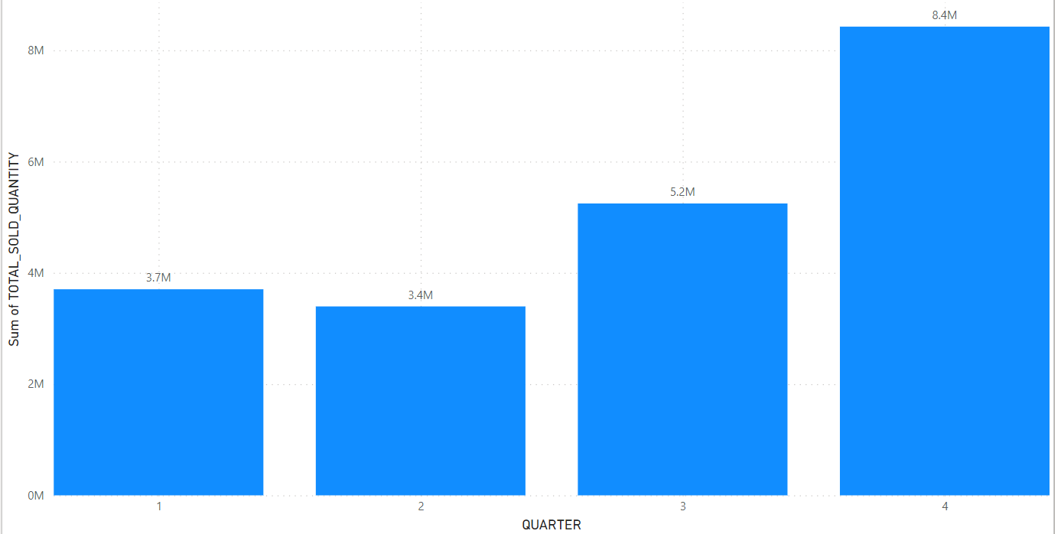
Quarter 4 has Maximum Total Sold Quantity
Quarter 2 has minimum Total Sold Quantity

Slide 17
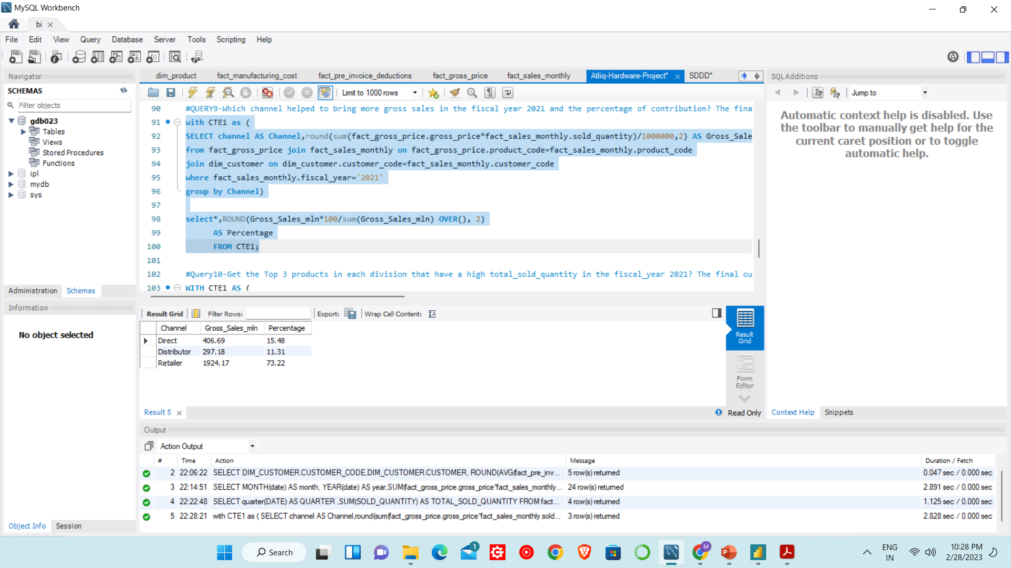
Question-9:-
Which channel helped to bring more gross sales in the fiscal year 2021 and the percentage of contribution? The final output contains these fields,
channel
gross_sales_mln
percentage
Output:-

Slide 18
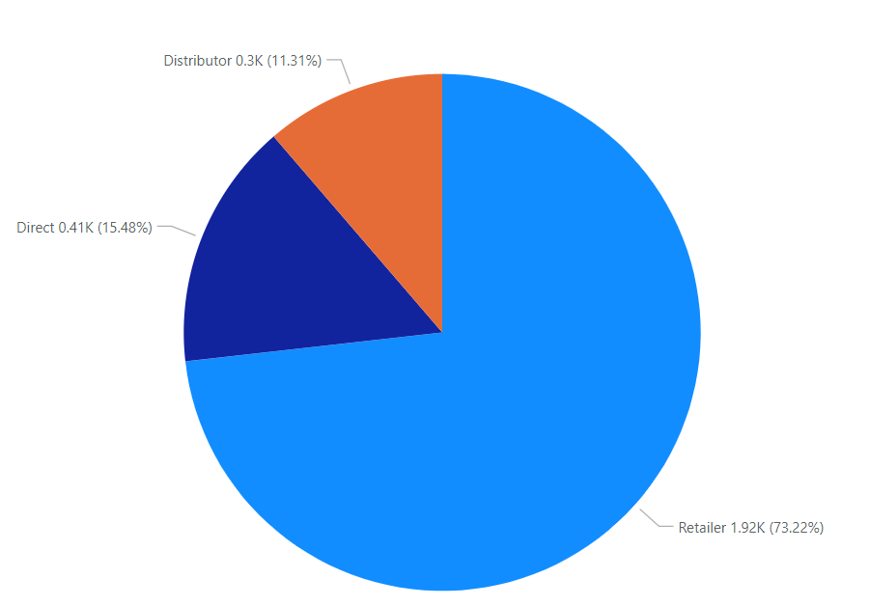
Retailer channel has maximum gross sales with 73.22%
Distributor channel has minimum gross sales with 11.3%

Slide 19
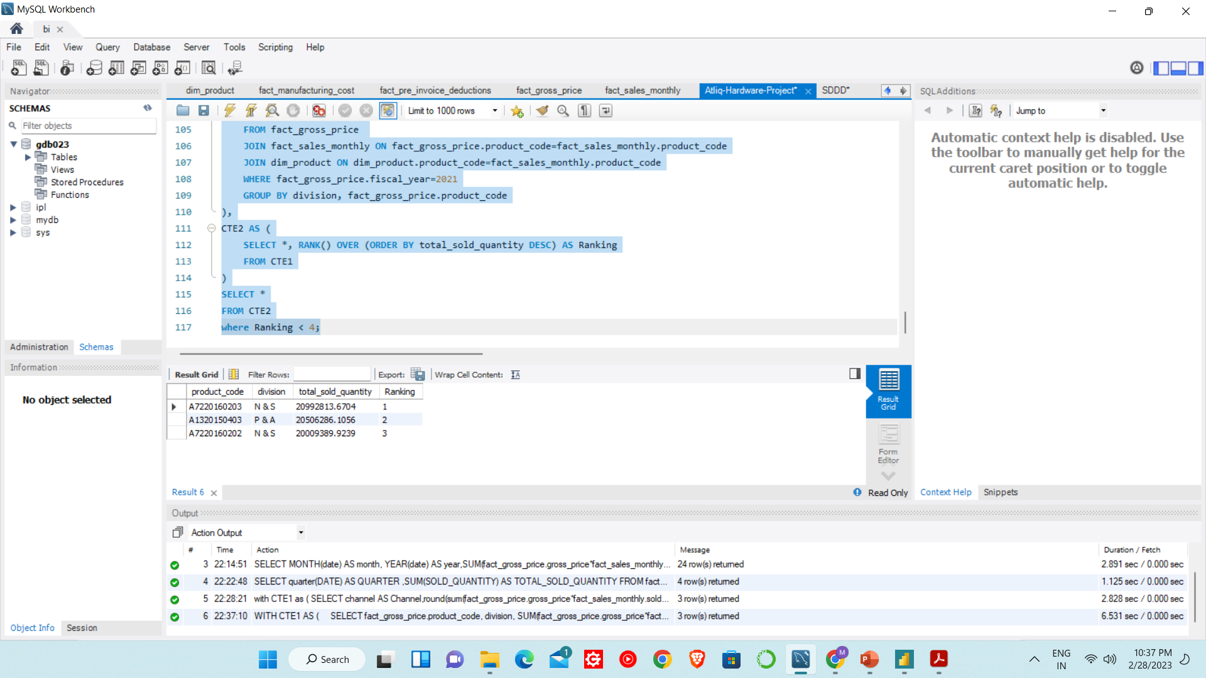
Question-10:-
Get the Top 3 products in each division that have a high total_sold_quantity in the fiscal_year 2021? The final output contains these fields,
division
product_code
Output:-

Slide 20
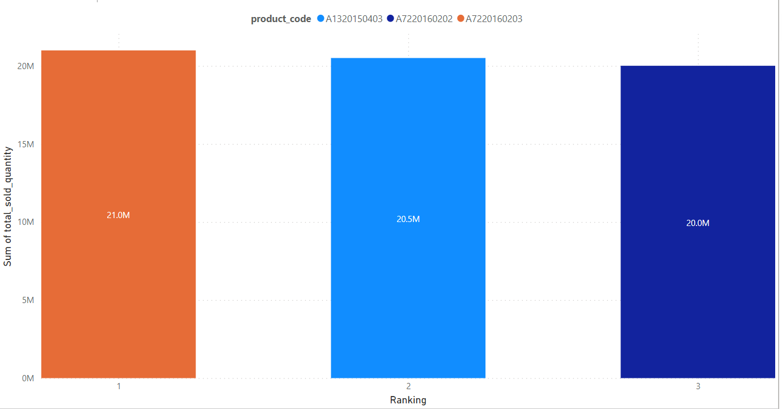
'AQ Wi Power Dx2’ has 1st ranking with 21M total sold quantity

Slide 21
THANK YOU

